Slide 1
APS CEC Practical Nursing Program
Parent Information Meeting
Class of 2022
Predicted graduation date - May 12, 2022

Slide 2
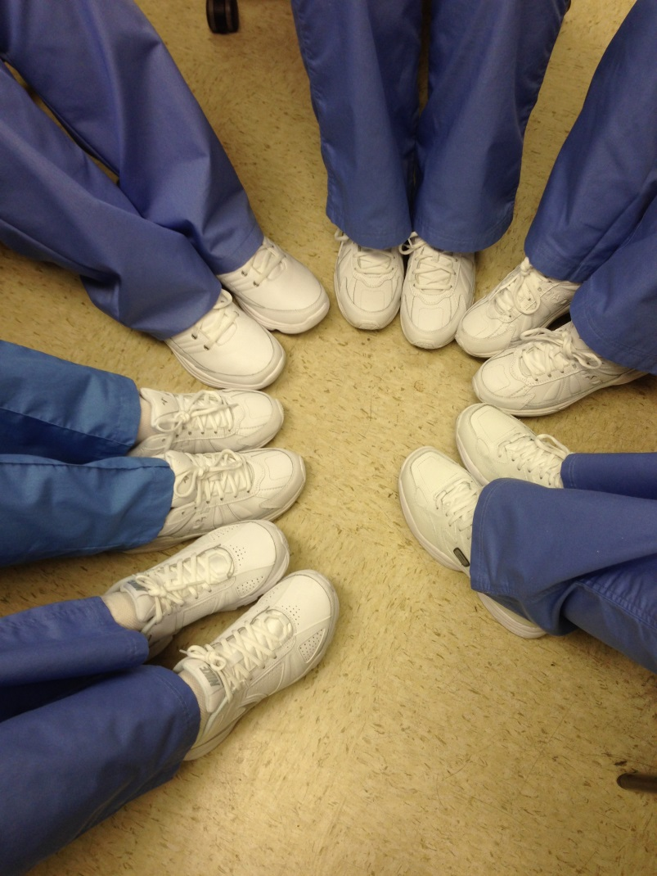
Purpose
WELCOME TO THE CEC FAMILY
Information meeting for parents and students regarding expectations for the next 5 semesters.
Answer questions
Relieve concerns
Decrease anxiety

Slide 3
NAMES & NUMBERS YOU NEED TO KNOW ECA / CEC # (505) 247-3658
Patrick Arguelles, Principal ECA and CEC
Ext: 45599 arguelles@aps.edu
Rebekah Floryance, Assistant Principal ECA and CEC
Ext: 45597 Floryance@aps.edu
Lynn Ramsey, ECA and CEC Councilor
Ext: 45595 RAMSEY_L@aps.edu
Connie A Baker, PN and NA program Director
Ext 45517 baker_c@aps.edu
Pat Kious, PN Program admission coordinator
Ext: 45436 Kious@aps.edu

Slide 4
Prepare for a vigorous curriculum…
The attrition rate is approximately 50%!
Sometimes grades are the problem…but this program is NOT about grades.
Sometimes psychosocial pressures are too much…remember they are just teenagers.
Sometimes parent’s expectations are unrealistic…this is not about you.
Your “A” student may NOT get “A’s” in this program…don’t make it harder on them than they make it on themselves.

Slide 5
Class and Clinical Schedule PM
Clinical
Beginning February
Mon – Tues
times vary depends on site
Theory
Wednesday – Friday
1245-1545
Theory
Fall semester
1240 – 1540 Mon – Friday
Spring Semester
January
Monday - Friday
1240-1540

Slide 6
A & P Class and Clinical Schedule PM
Anatomy & Physiology
A & P follows immediately after nursing theory.
Fall semester
1430 – 1550
Mon – Friday
Nursing Clinical
Beginning February
Mon – Tues
times vary depends on site
A & P
Wednesday – Friday
1430 - 1550

Slide 7
Class and Clinical Schedule
PLEASE - Do not plan appointments or any activities that interfere with class or clinical times
Every absence or tardy MUST be made up –
Minute for Minute
Hour for Hour

Slide 8
Summer Semester /Schedule
Summer semester begins immediately after Spring finals – early in May and continues until the end of June
Summer semester
Clinical 2 days a week
Theory 3 days a week
Some weekend days are required during the summer semester. Plan on at least one Sunday clinical day!
Do not make plans for summer vacations before July 3, 2021

Slide 9
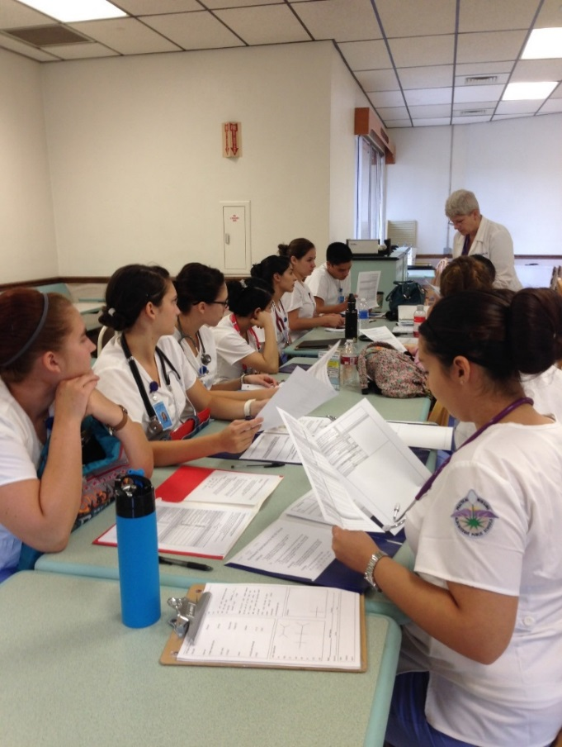
Senior Year - Schedule
Senior year
All Theory courses are held in the morning – 0645 – 0945 at CEC
Clinical begins in August of senior year.
Clinical rotations may be days, evenings, and/ or weekends
Fall and Spring semesters have SIGNIFICANT clinical components.

Slide 10
Student Resources
Students need to have
Internet access
A computer or e reader
Paper and printer
Students are required to complete a portion of the course via Google Classroom.
Students have full access to ATI tests, reviews, content.
Students have access to on-line database at UNM Health Sciences Library
Students have access and will have to use Simulation software

Slide 11
Transportation
AM
There is NO bus service to CEC for the morning session.
There IS a bus that will return students to their home high school
PM
There IS bus service for afternoon students. Busses will pick up students at the home high school and then return them to their home high school

Slide 12
Transportation
There is NO transportation to and from clinical sites.
Students must have their own transportation beginning in February of their Junior year.
Carpooling issues are NOT taken into consideration when developing clinical rotations schedules.

Slide 13
Forms and Parent Signatures
Physical Exam
Physician Pre-entrance Physical Exam
Parent report to school
Essential Functions
Transportation
Parent /student agreement
Proof of Health Insurance
VA paperwork
URINE DRUG SCREENING IS MANDATORY AND MUST BE PAID BY STUDENT/PARENT

Slide 14
Forms due August 28, 2020
All forms must be returned to CEC by August 28, 2020
Forms can be hand carried
Mailed
Scanned and Emailed
Immunization forms
We MUST have a COPY of all immunizations
Varicella
Hep B series (3 injections)
MMR
TdaP
TB – Mantoux test

Slide 15
Forms
Students will receive a list of medical abbreviations and lab values via email the last week of June
Students are expected to memorize the information
There will be a quiz on the first day of school covering the information.
Ideas to help them memorize
On line quizzes
Flash cards
Quiz-lets
Parent Q & A
Have fun with your newly learned medical abbreviations.

Slide 16
COSTS
1st Semester $150.00 for ATI prep materials
Lab fee - $50.00 each semester thereafter
Due at the beginning of each semester
UNPAID FEES will delay graduation
Student uniforms
Specific information will be provided at a later date
Stethoscope, BP cuff, pen light, bandage scissors
All white Nursing shoes (needed for 2nd semester)
Watch
Misc. supplies
Some Textbooks

Slide 17
Requirements for Program
CPR is mandatory for entrance into the program
Students can take CPR here at CEC
Or through an alternate provider
The cost is $20 - $50
Students will received an email
regarding the process for CPR

Slide 18
Health Records
Physical exam
TB Test (annually)
Flu vaccine (annually)
Immunization records
Varicella
TB
MMR
Hep B series (3)
TdaP
Essential functions
DUE DATE FOR ALL
FORMS IS:
August 28, 2020

Slide 19
Insurance
The family must provide HEALTH INSURANCE for the nursing student.
APS has low cost student policies available for purchase at the beginning of the school year.

Slide 20
Attendance
No late assignments are accepted
Minimum passing grade is 75%
Grades are not “rounded up”
Students are expected to be in class every day
On time
Prepared
Actively involved

Slide 21
Remember to WEAR YOUR MASKS WHEN YOU COME TO CEC FOR CPR

Slide 22
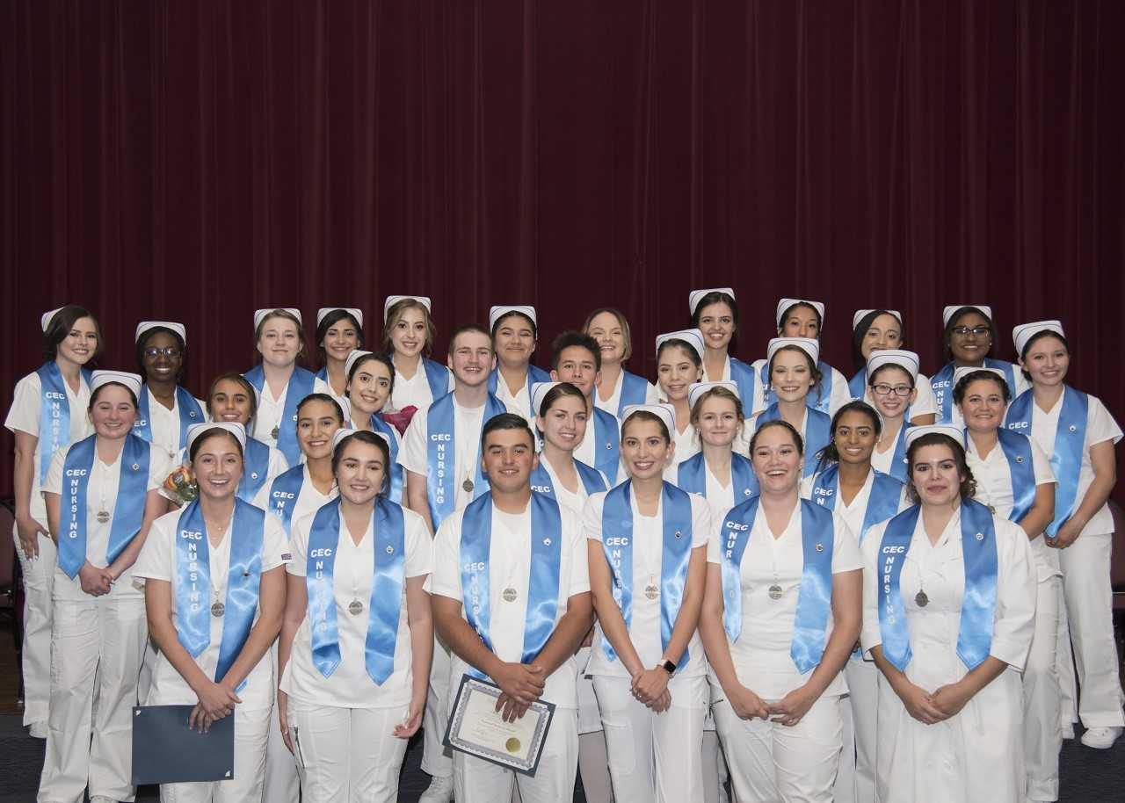
Questions

